Slide 1

Sentiment Analysis and Topic Detection for Fake News Classifier
IS424 g3t4
Foo Chuan Geng
Loh Xiao Binn
MoH Qing Loong Darren
Toh Ying Hui
Notes:
Good evening everyone. We are team 6 . For our project, We built a fake news classifier! But not just a fake classifier, we present to you our project title, sentiment analysis and topic detection for fake news classifier!
1. intro [slide 1-4] - celine
2. Methododolgy [Slide 5 - 10] – ying hui
3. Textblob and vader – Darren
4. K means 15 – 16 – cg
5. LDA [slide 17 - 18] -celine
3. 4. 5. - use library
6. Results [Slides 19 onwards ] – cg

Slide 2



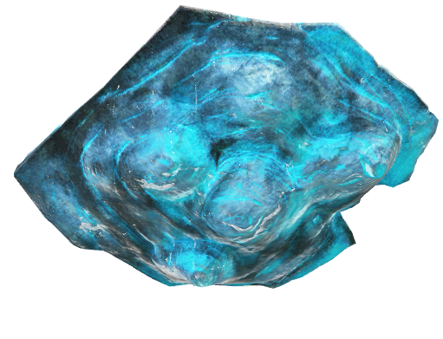


Sentiment analysis and topic detection for fake news classifier
Title
Introduction
Motivation
Lit-Review
Datasets
Methodology
Results & Discussion
Conclusion & Future Work ☺
Notes:
From our last presentation, we all know that learning how to identify fake news is ever so important. But does just the truthiness of news matter?
When we read an article, we have what we call reader’s emotion. Is it a positive article? Negative? Or just neutral? What is it about?
They said reading news will help us understand what is going on in the world, but how do we draw the dots? How do we identify the patterns? Here, we want to really dive deep and explore the sentiments of news articles and identify patterns in their topics with regards to their label as fake or not. As you can see here, we will be looking at working on both clustering and classification! Our end goal is to see if adding sentiment analysis and topic detection will improve the accuracy of the fake news detector

Slide 3

Problem statement
The plethora of misleading false information in this time where data is highly accessible causes confusion and frustrations to both individuals and businesses.
Fast sharing on the internet (social media & news channels)
What do we want to solve?
The Internet’s double-edged sword
Title
Introduction
Motivation
Lit-Review
Datasets
Methodology
Results & Discussion
Conclusion & Future Work ☺
Notes:
Here we answer the question, what is the problem we are trying to solve?
So the internet is a double edged sword, it provides us with so much information but can we trust it all? No. and then comes the problem, how do we know what’s fake and what’s real. And how do we know for sure?

Slide 4

Motivation
Eliminate/ overcome the disadvantages of online news platforms
Create a better environment for safe sharing of information
Identify what’s true and what’s false
Understand trends in false news
Title
Introduction
Motivation
Lit-Review
Datasets
Methodology
Results & Discussion
Conclusion & Future Work ☺
Notes:
The motivation behind our project is to eliminate and try to overcome the disadvantages of online news platform so that there can be a better environment for safe sharing of information. It will also help us to understand the trends in false news and learn to identify what’s true and what’s not. To elaborate a little more on the disadvantages of online news platforms is that it can be shared very quickly and this kind of news can cause a lot of confusion.

Slide 5
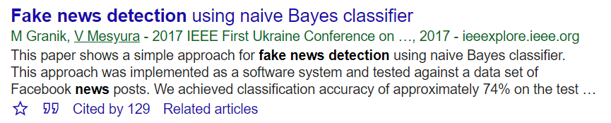
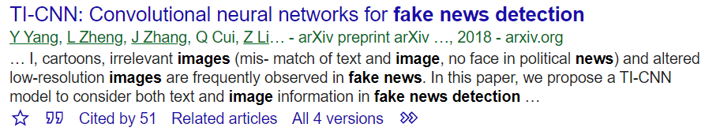
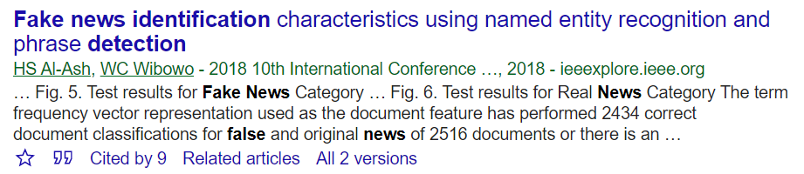
Naïve bayes classifier
→ There’s also SVM and k-NN (most common approaches)
Text & image resolution analysis
Specified entities detection
Title
Introduction
Motivation
Lit-Review
Datasets
Methodology
Results & Discussion
Conclusion & Future Work ☺
Notes:
For our literature review, we searched up use cases of fake news detection and read up on the classification algorithms which were used. Some of the examples that we found were using naïve bayes classifier, text & image resolution analysis and specified entities detection. In the next slide, [change to next slide]
Citations
Granik, M., & Mesyura, V. (2017, May). Fake news detection using naive Bayes classifier. In 2017 IEEE First Ukraine Conference on Electrical and Computer Engineering (UKRCON) (pp. 900-903). IEEE.
Yang, Y., Zheng, L., Zhang, J., Cui, Q., Li, Z., & Yu, P. S. (2018). TI-CNN: Convolutional neural networks for fake news detection. arXiv preprint arXiv:1806.00749.
Al-Ash, H. S., & Wibowo, W. C. (2018, July). Fake news identification characteristics using named entity recognition and phrase detection. In 2018 10th International Conference on Information Technology and Electrical Engineering (ICITEE) (pp. 12-17). IEEE.

Slide 6
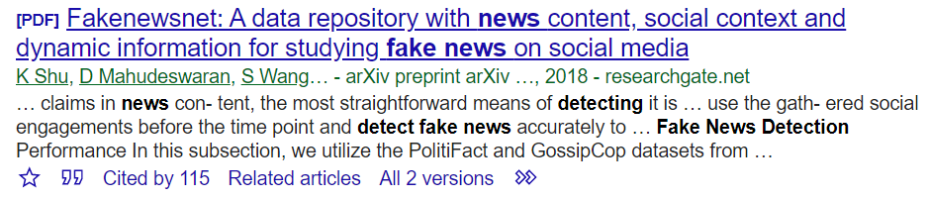
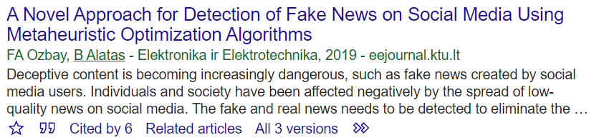
Time-based analysis
Shift of focus to optimization using Grey Wolf Optimisation and Salp Swarm Optimisation
Title
Introduction
Motivation
Lit-Review
Datasets
Methodology
Results & Discussion
Conclusion & Future Work ☺
Notes:
From here, we can also see that some examples of fake news detector uses a time-based analysis or shifting of focus to optimization using Grey Wolf Optimization and Salp Swarm Optimisation.
Citations
Shu, K., Mahudeswaran, D., Wang, S., Lee, D., & Liu, H. (2018). Fakenewsnet: A data repository with news content, social context and dynamic information for studying fake news on social media. arXiv preprint arXiv:1809.01286, 8.
Ozbay, F. A., & Alatas, B. (2019). A Novel Approach for Detection of Fake News on Social Media Using Metaheuristic Optimization Algorithms. Elektronika ir Elektrotechnika, 25(4), 62-67.

Slide 7
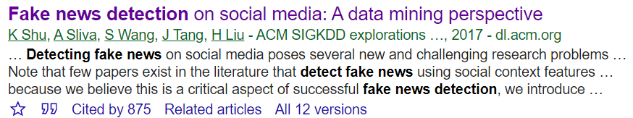
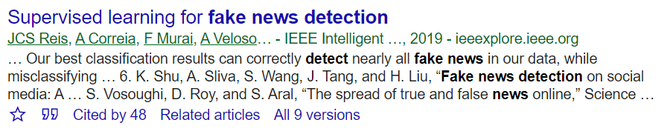
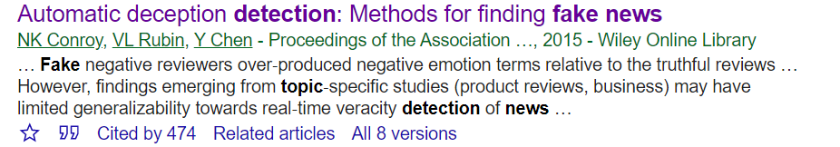
Little has been done on feature analysis with text
The study that emphasizes the importance of features in the classification of fake news
Emotion analysis & Topic detection
Title
Introduction
Motivation
Lit-Review
Datasets
Methodology
Results & Discussion
Conclusion & Future Work ☺
Notes:
We found that there are some examples of fake news detection based solely on the topic content, analysis of the comment section, or keyword detection. There is also one example which was using emotion analysis and topic detection. However, there has been no previous work on using sentiment analysis and topic detection to build a fake news detector, so we decided to explore that for our fake news classifier project.
Citations
Shu, K., Sliva, A., Wang, S., Tang, J., & Liu, H. (2017). Fake news detection on social media: A data mining perspective. ACM SIGKDD explorations newsletter, 19(1), 22-36.
Conroy, N. K., Rubin, V. L., & Chen, Y. (2015). Automatic deception detection: Methods for finding fake news. Proceedings of the Association for Information Science and Technology, 52(1), 1-4.
Reis, J., Correia, A., Murai, F., Veloso, A., Benevenuto, F., & Cambria, E. (2019). Supervised Learning for Fake News Detection. IEEE Intelligent Systems, 34(2), 76–81. https://doi.org/10.1109/mis.2019.2899143

Slide 8
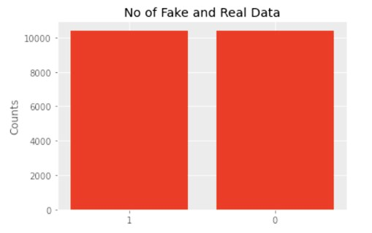
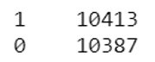
Training and testing data – from Kaggle
Field Name​ | Data Type​ | Description​
id​ | int64​ ​ | Unique ID for a news article​
title​ | object​ ​ | The title of a news article​
author​ | object​ ​ | Author of a news article​
text​ | ​ object​ | The text content of the article(may be incomplete)​
topic​ | string​ | Category of news​
sentiment​ | integer​ | Neutrality from title​
label​ | int64​ | A label that marks the article as potentially unreliable​ 1: unreliable​ 0: reliable​
dropped
From topic classifier model and sentiment classifier model​
Test dataset is not labelled
Title
Introduction
Motivation
Lit-Review
Datasets
Methodology
Results & Discussion
Conclusion & Future Work ☺
Notes:
For our training and testing data, we will be using the same dataset for all 3 models & the outputs of the sentiment analysis and topic classifier will be used to train the fake news classifier model.

Slide 9
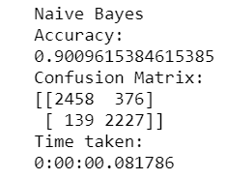
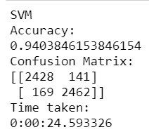
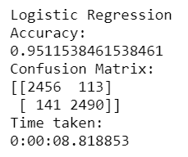
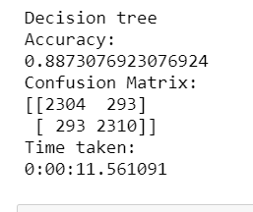
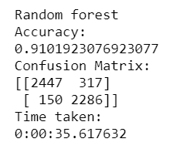
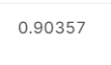
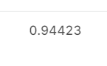
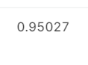
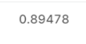
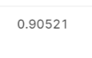

Throwback to prelim model
Logistic Regression for classification: Fake News Detection
Sentiment analysis | Topic modelling | Fake news classifier | Analysis
Using count vectorizer
Score:
Score:
Score:
Score:
Score:
Title
Introduction
Motivation
Lit-Review
Datasets
Methodology
Results & Discussion
Conclusion & Future Work ☺
Notes:
Control Model
For a recap of our preliminary model, we found that out of the models we built, Naïve Bayes, SVM (Support Vector Machine) and Logistic Regression, the logistic regression model achieved the highest accuracy of 95%. After learning Decision Tree and Random Forest in class, we also built those 2 models to see if they are able to achieve a better accuracy than Logistic Regression. However, after evaluating the results, logistic regression is found to still have the highest accuracy for our fake news classifier. Therefore, we will be using the results from logistic regression model as our baseline model for comparison.
Decsion Tree configuration :
clf = DecisionTreeClassifier(criterion="entropy",random_state=0)
Random forest configuration:
randForest = RandomForestClassifier(n_estimators= 100, random_state=424)

Slide 10
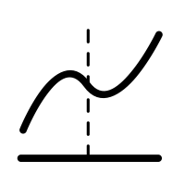




METHODOLOGY overview
Logistic Regression for Classifying Fake News (Baseline Model)
Sentiment Analysis using TextBlob and Vader
Topic Detection using K-Means and LDA
Run predictions on test dataset for each model and compare their accuracy against baseline model
Training models based on combined outputs.
(E.g. Text + TextBlob + K-Means, Text +Vader + LDA)
Combine Outputs from Sentiment Analysis and Topic Detection
Title
Introduction
Motivation
Lit-Review
Datasets
Methodology
Results & Discussion
Conclusion & Future Work ☺
Notes:
This will be the overview of our methodology in this project. From our preliminary results, we chose logistic regression to be our baseline model. Following which we performed sentiment analysis using Textblob and Vader, and did topic detection using K-Means and Latent Dirichlet Allocation (LDA). The outputs from these models would then be combined in the form of 4 pairs, example the main text data + textblob and K-Means outputs, which will then be used to train our models and make predictions using test data, and submitting them to Kaggle before comparing the accuracy against our baseline model.

Slide 11
Sentiment analysis
Title
Introduction
Motivation
Lit-Review
Datasets
Methodology
Results & Discussion
Conclusion & Future Work ☺

Slide 12
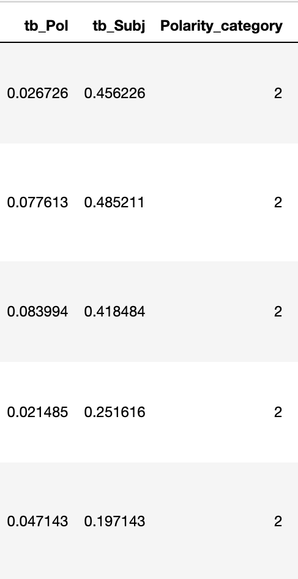
Textblob
A library simplifying text processing tasks. It provides properties for classification, part-of-speech tagging, noun phrase extraction, sentiment analysis
What we use: 'Sentiment' property is used to capture the emotions embedded, ascertain the subjectivity of the textual information
What we want to find: Polarity measures emotional level from negative to positive[-1.0, 1.0] Subjectivity measures agreement level from highly objective to highly subjective [0.0, 1.0]
e.g. train['tb_pol'] = [b.sentiment.polarity for b in desc_blob]
Title
Introduction
Motivation
Lit-Review
Datasets
Methodology
Results & Discussion
Conclusion & Future Work ☺
Notes:
Textblob Methodology
For our project, textblob provides the feature to assess the emotions within the text document. We want to know about the emotional classification in the text, hence we measure polarity, which is the emotional extent of the meaning of each word, whereas subjectivity is to understand the agreement level of the content, whether it is highly objective, or subjective. It is important to know these as they may be similar to characteristics that fake news usually holds

Slide 13
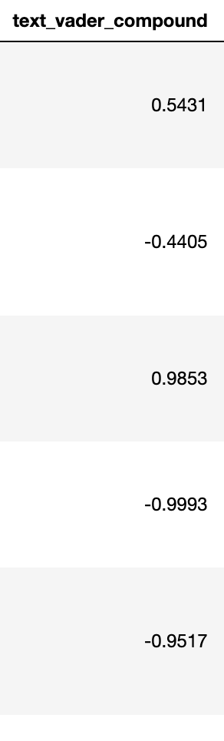
Vader
VADER (Valence Aware Dictionary and Sentiment Reasoner) is a lexicon and rule-based sentiment analysis tool that is specifically attuned to sentiments expressed in social media
'polarity_scores()' method is used to capture the emotions embedded, which gives negative, neutral, positive, compound
What we want to find: Vader's compound score is normalised between –1 to 1, by picking up intrinsic emotion category of each word
e.g. train['text_vader_compound'] = [analyser.polarity_scores(v)['compound'] for v in train_copy['text']]
Title
Introduction
Motivation
Lit-Review
Datasets
Methodology
Results & Discussion
Conclusion & Future Work ☺
Notes:
Vader Methodology
Vader is another tool to find out about the sentiments of a text document, the difference lies in it being able to find out compound, which is a measure of intrinsic emotions behind each word; after it is summed, weighted & normalised. This provides another analytical focal point about the overall sentiment of the text where Textblob is unable to do so.

Slide 14
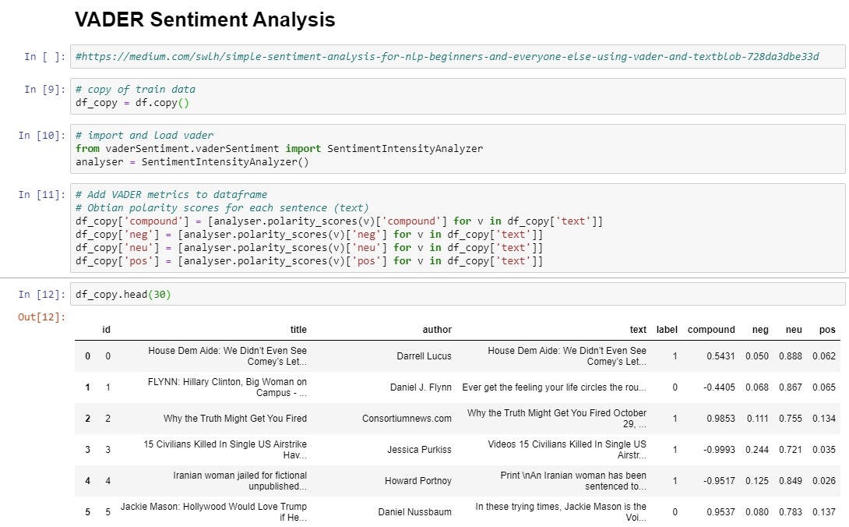
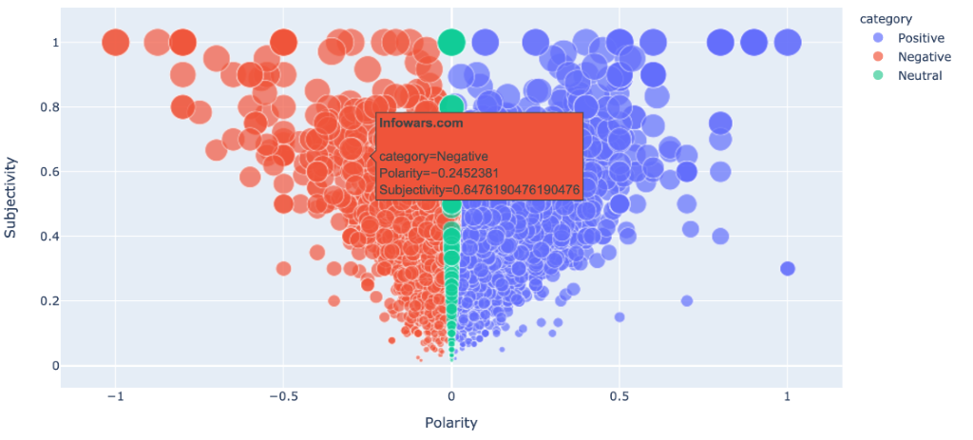
Let’s model it! – Sentiment analysis
Classification
News...?
Fake News!!!!!
Title
Introduction
Motivation
Lit-Review
Datasets
Methodology
Results & Discussion
Conclusion & Future Work ☺
Notes:
Results/visualization for textblob/vader
The visualisation results shows the sentiments of each author's text by sifting through the scatter plot, making it convenient to find out relevant details, while vader sentiment results is output through manipulating the dataframe. The polarity and subjectivity values gives us another layer of consideration as to determine if the text document is truly misinformation. In this example, 'infowars' has a polarity of 0.245, subjectivity of 0.648, it tells us that the content could be misinformation because there is a lot of negative emotions and there is a lot of subjective information. On the other hand, vader explores a fuller range of emotions, where compound gives an overaching result, without the need to analyse different emotion category individually and be confused by the whole set of numbers. For instance, 0.534 score tells us that the particular document is of positive sentiment, as the score >= 0.05.

Slide 15
Topic modelling
Title
Introduction
Motivation
Lit-Review
Datasets
Methodology
Results & Discussion
Conclusion & Future Work ☺

Slide 16
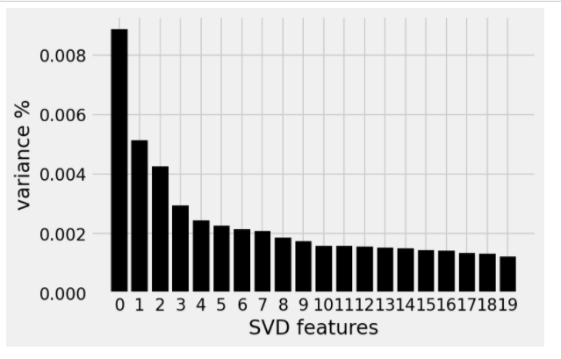
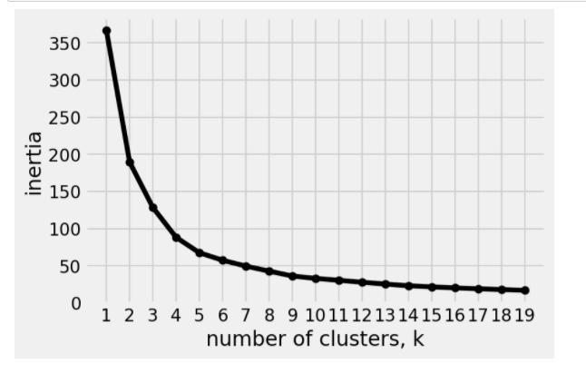
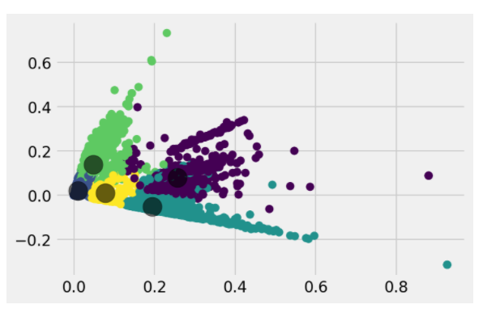
k-means
Clustering
Tf-idf the Text data
Run it through SVD
Select number of cluster
Run Kmeans
Title
Introduction
Motivation
Lit-Review
Datasets
Methodology
Results & Discussion
Conclusion & Future Work ☺
Notes:
Will explain more here

Slide 17
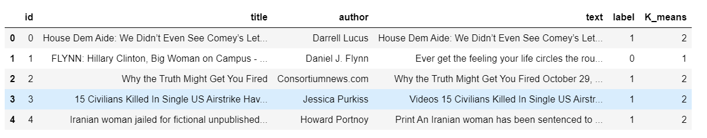
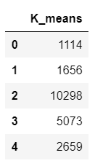
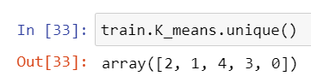
Clustering
Title
Introduction
Motivation
Lit-Review
Datasets
Methodology
Results & Discussion
Conclusion & Future Work ☺
Notes:
Will explain more here

Slide 18
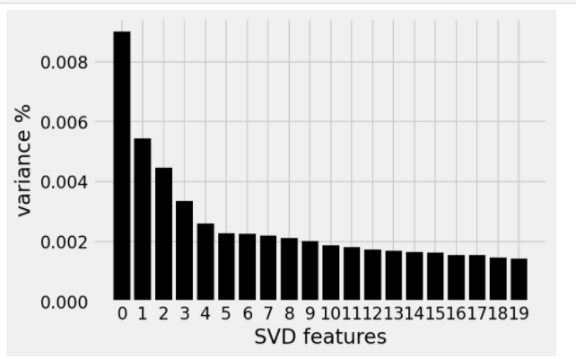
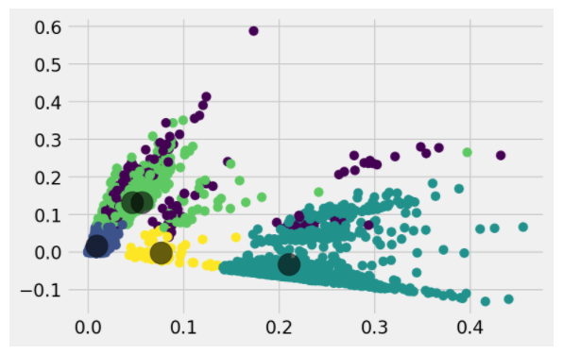
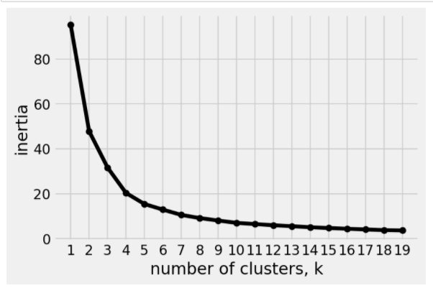
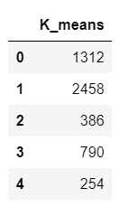
Title
Introduction
Motivation
Lit-Review
Datasets
Methodology
Results & Discussion
Conclusion & Future Work ☺
Notes:
So this process we do it for the same for the test dataset
Here are the visualization and outputs Kmeans for test sets

Slide 19
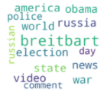
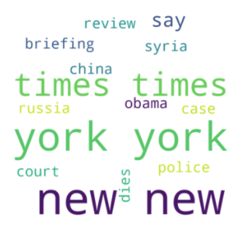
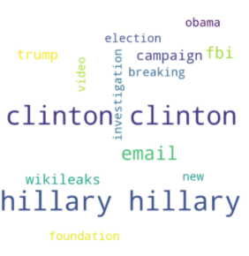
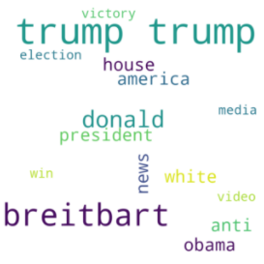
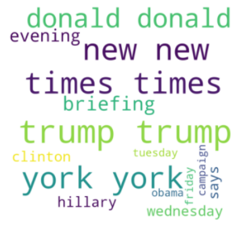
Topics from k-means (WordCloud-train)
Clustering
News published by brietbart about the police, war and elections, related to Russia and America
News published by the New York times about the police, China and Obama.
News regarding the investigations by the FBI regarding Hillary Clinton during the election campaigns.
News published by brietbart about the American presidency elections involving trump, racism and winning
News published by the New York times about Donald Trump.
Title
Introduction
Motivation
Lit-Review
Datasets
Methodology
Results & Discussion
Conclusion & Future Work ☺
Notes:
Wordcloud

Slide 20
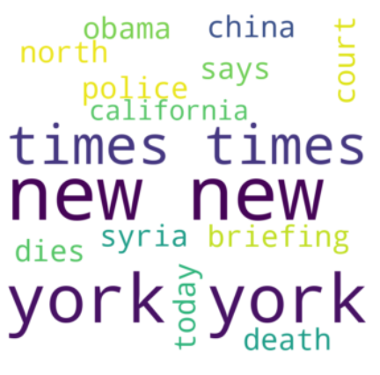
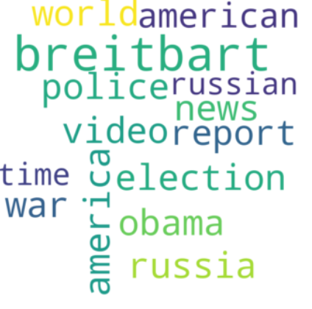
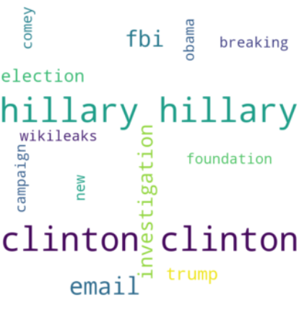
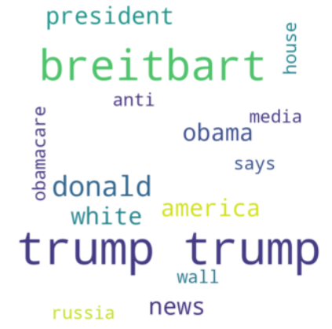
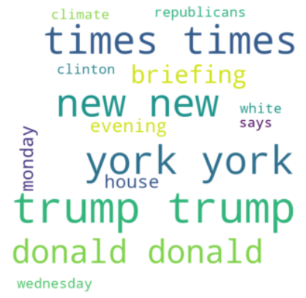
Topics from k-means (WordCloud-test)
Clustering
News published by the New York Times about a court case that involves death in north California
News published by breitbart about the war and elections between Russia and America
Investigations on Hillary Clinton regarding campaign and wikileaks
News published by Brietbart about Trump and what he has to say about obamacare
News published by the New York Times about Donald Trump
Title
Introduction
Motivation
Lit-Review
Datasets
Methodology
Results & Discussion
Conclusion & Future Work ☺
Notes:
Wordcloud

Slide 21
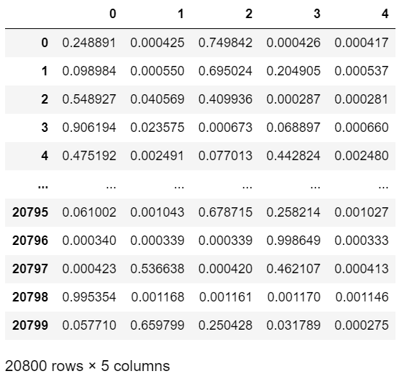
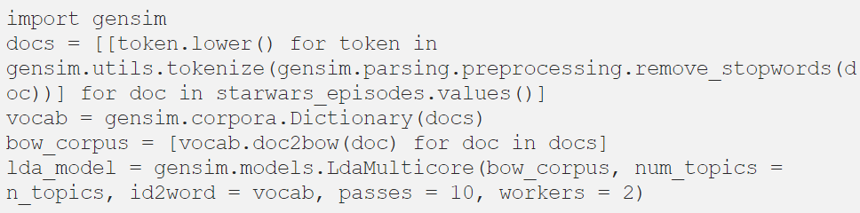
LDA- a probabilistic model
Probabilities per topic
From our k-means analysis: n_topics = 5
Input data {id: text}; text → vectorizing with corpus
Extract dominant topic for clustering, infer from the topic’s % contribution via keywords
Title
Introduction
Motivation
Lit-Review
Datasets
Methodology
Results & Discussion
Conclusion & Future Work ☺
Notes:
LDA is a probabilistic model, meaning that it calculates the probability that it belongs to a certain cluster, for each cluster. It is like the percentage of similarity for each cluster. Unfortunately, it cannot name the discovered topics, but it can mention what the most likely words are that belong to each topic. On the right you can see that we have 5 topics and you can see for each topic, there is a probability output. We chose 5 topics from our previous kmeans analysis.
Next, lets take a look at the code taken from one of our reference articles when building this model. We use genism library to build the model. And our input data is as shown, id and then the text. The text is vectorized with corpus, like in a bag of words, similar to tf-idf method.
What we have done is also to extract the most dominant topic for each row of data to finalize this clustering.

Slide 22
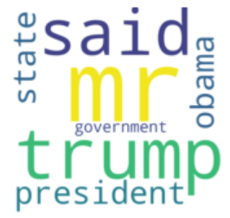
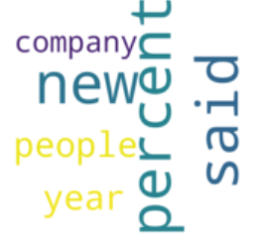



5 Topics from LDA (WordCloud – Train)
Clustering
Things said by presidents trump and Obama about state
Yearly statistical information about companies
News about Clinton and trump about people
News reports about new information said (secondary) “he said, she said”
News text in foreign language
Title
Introduction
Motivation
Lit-Review
Datasets
Methodology
Results & Discussion
Conclusion & Future Work ☺
Notes:
Here are the wordcloud outputs for the train dataset. So in order, we have.

Slide 23





5 Topics from LDA (WordCloud – test)
Clustering
Secondary information about people regarding new topics “he said, she said”
Things president trump said
News regarding trump and Hillary Clinton during the election, about the election and people (perhaps policies)
News text in foreign language
World news regarding government and war in Russia and Syria
Title
Introduction
Motivation
Lit-Review
Datasets
Methodology
Results & Discussion
Conclusion & Future Work ☺
Notes:
And here are the topics of the test dataset.

Slide 24


Clustering on train & test data
Clustering
Train set LDA counts
Test set LDA counts
News about Clinton and Trump about people
Things president Trump said
Title
Introduction
Motivation
Lit-Review
Datasets
Methodology
Results & Discussion
Conclusion & Future Work ☺

Slide 25




Let’s model it! - Topic detection
Clustering
Attribute | K-Means | Latent Dirichlet Allocation
# clusters | {0,1,2,3,4} → 5 | {3,4,5,6,7} → 5
Vectorizer | tf-idf | Gensim corpus (bag of words)
LDA
K-means
Train Data
Train ‘Data
Test Data
Test Data
Title
Introduction
Motivation
Lit-Review
Datasets
Methodology
Results & Discussion
Conclusion & Future Work ☺
Notes:
Here’s a summary of our topic modelling.

Slide 26

Methodology for "improved" model
Label encoder for Polarity Category [Textblob] [Ordinal data]
For LDA and Kmeans – One hot encoding [Nominal data]
Text data – Preprocess data then count vectorizer
Add text data together with the Topic model and sentiment analysis features in a matrix format as Input to Logistic regression model
Title
Introduction
Motivation
Lit-Review
Datasets
Methodology
Results & Discussion
Conclusion & Future Work ☺
Notes:
Will explain more here

Slide 27


Title
Introduction
Motivation
Lit-Review
Datasets
Methodology
Results & Discussion
Conclusion & Future Work ☺
Notes:
For eg. Textblob and kmeans

Slide 28
Text data + Textblob+ K Means
Text data + Textblob+ LDA
Text data + Vader+ K Means
Text data + Vader+ LDA
Logistic Regression
Logistic Regression
Logistic Regression
Logistic Regression
Compare !
Title
Introduction
Motivation
Lit-Review
Datasets
Methodology
Results & Discussion
Conclusion & Future Work ☺

Slide 29








Results(build from baseline model)
Score:
Score:
Score:
Score:
Title
Introduction
Motivation
Lit-Review
Datasets
Methodology
Results & Discussion
Conclusion & Future Work ☺
Notes:
Using COUNTVECTORIZER
Submitted the predictions from all 4 models to Kaggle
From the results, the model which was trained using Vader for sentiment analysis and Kmeans for topic detection achieved the highest accuracy of 95.054%

Slide 30




Title
Introduction
Motivation
Lit-Review
Datasets
Methodology
Results & Discussion
Conclusion & Future Work ☺

Slide 31


So... did it work?
Baseline model | Logistic Regression (Vader + LDA)
Insignificant increase of accuracy in fake news detection as compare to the baseline model
Improved understanding of the topics and sentiment within dataset
Title
Introduction
Motivation
Lit-Review
Datasets
Methodology
Results & Discussion
Conclusion & Future Work ☺
Notes:
Show both log reg right
I will explain more here......

Slide 32


Future work
Warning: 99.9% Fake
Explore other attributes for better accuracy!
Pass features to NN as input to see if accuracy will increase !
Are you sure you want to share this?
Title
Introduction
Motivation
Lit-Review
Datasets
Methodology
Results & Discussion
Conclusion & Future Work ☺
Notes:
More accurate detection using not just topic and sentiment but also emotion!
Tags on social media on warning of low/med/high rating of fake news rating.

Slide 33
References for fake news detection
Brownlee, J. (2020, August 17). Ordinal and One-Hot Encodings for Categorical Data. Retrieved November 02, 2020, from https://machinelearningmastery.com/one-hot-encoding-for-categorical-data/
Konkiewicz, M. (2020, May 27). What are categorical variables and how to encode them? Retrieved November 02, 2020, from https://towardsdatascience.com/what-are-categorical-variables-and-how-to-encode-them-6e77ddc263b3
Roozbeh Bakhshi, Rahul Pant, Kota Mori, Akshay Rana, & Dr Nisha Arora. (1967, August 01). Scikit-learn's LabelBinarizer vs. OneHotEncoder. Retrieved November 02, 2020, from https://stackoverflow.com/questions/50473381/scikit-learns-labelbinarizer-vs-onehotencoder
Brownlee, J. (2020, June 30). Why One-Hot Encode Data in Machine Learning? Retrieved November 02, 2020, from https://machinelearningmastery.com/why-one-hot-encode-data-in-machine-learning/
Srinidhi, S. (2020, January 09). Label Encoder vs. One Hot Encoder in Machine Learning. Retrieved November 02, 2020, from https://medium.com/@contactsunny/label-encoder-vs-one-hot-encoder-in-machine-learning-3fc273365621
Title
Introduction
Motivation
Lit-Review
Datasets
Methodology
Results & Discussion
Conclusion & Future Work ☺
Notes:
Labs:

Slide 34
References for fake news detection
BonsonBonson 1. (1966, April 01). Adding pandas columns to a sparse matrix. Retrieved October 13, 2020, from https://stackoverflow.com/questions/41927781/adding-pandas-columns-to-a-sparse-matrix
Sung, J. (2018, April 24). Natural Language Processing: Count Vectorization and Term Frequency - Inverse Document Frequency. Retrieved November 02, 2020, from https://medium.com/@joshsungasong/natural-language-processing-count-vectorization-and-term-frequency-inverse-document-frequency-49d2156552c1
Sethi, A. (2020, June 25). Categorical Encoding: One Hot Encoding vs Label Encoding. Retrieved November 02, 2020, from https://www.analyticsvidhya.com/blog/2020/03/one-hot-encoding-vs-label-encoding-using-scikit-learn/
Buttigieg, P., Ramette, A., Desbois, D., Coppi, R., Gil, M., & Kiers, H. (2020, October 24). Is a Likert-type scale ordinal or interval data? Retrieved November 02, 2020, from https://www.researchgate.net/post/Is_a_Likert-type_scale_ordinal_or_interval_data
Types of Variable. (n.d.). Retrieved November 02, 2020, from https://statistics.laerd.com/statistical-guides/types-of-variable.php
Title
Introduction
Motivation
Lit-Review
Datasets
Methodology
Results & Discussion
Conclusion & Future Work ☺
Notes:
Labs:

Slide 35
References for topic modelling
LDA
Mohammed, T. J. (2019, May 12). NLU: Topic Discovery [Web log post]. Retrieved September 25, 2020, from https://medium.com/@b.terryjack/nlu-topic-discovery-85b492c4beb7
Thushan, G. (2018, August 23). Intuitive Guide to Latent Dirichlet Allocation [Web log post]. Retrieved September 25, 2020, from https://towardsdatascience.com/light-on-math-machine-learning-intuitive-guide-to-latent- dirichlet- allocation-437c81220158
K-means
Foley, D. (2019, February 8). K-Means Clustering [Web log post]. Retrieved September 24, 2020, from https://towardsdatascience.com/k-means-clustering-8e1e64c1561c
Kavyazin, D. (2019, February 21). Principal Component Analysis and k-means Clustering to Visualize a High Dimensional Dataset. Retrieved November 03, 2020, from https://medium.com/@dmitriy.kavyazin/principal-component-analysis-and-k-means-clustering-to-
visualize-a-high-dimensional-dataset-577b2a7a5fe2
Title
Introduction
Motivation
Lit-Review
Datasets
Methodology
Results & Discussion
Conclusion & Future Work ☺

Slide 36
References for sentiment analysis
Kleppen, E. (2020, February 10). Simple Sentiment Analysis for NLP Beginners and Everyone Else using VADER and TextBlob. Retrieved October 11, 2020, from https://medium.com/swlh/simple-sentiment-analysis-for-nlp-beginners-and-everyone- else-using-vader-and-textblob-728da3dbe33d
Wang, J. (2020, September 16). Sentiment Analysis & Topic Modeling for Hotel Reviews. Retrieved October 10, 2020, from https://medium.com/swlh/sentiment-analysis- topic-modeling-for-hotel-reviews-6b83653f5b08
Title
Introduction
Motivation
Lit-Review
Datasets
Methodology
Results & Discussion
Conclusion & Future Work ☺

Slide 37
Other References
Granik, M., & Mesyura, V. (2017, May). Fake news detection using naive Bayes classifier. In 2017 IEEE First Ukraine Conference on Electrical and Computer Engineering (UKRCON) (pp. 900-903). IEEE.
Yang, Y., Zheng, L., Zhang, J., Cui, Q., Li, Z., & Yu, P. S. (2018). TI-CNN: Convolutional neural networks for fake news detection. arXiv preprint arXiv:1806.00749.
Al-Ash, H. S., & Wibowo, W. C. (2018, July). Fake news identification characteristics using named entity recognition and phrase detection. In 2018 10th International Conference on Information Technology and Electrical Engineering (ICITEE) (pp. 12-17). IEEE.
Shu, K., Mahudeswaran, D., Wang, S., Lee, D., & Liu, H. (2018). Fakenewsnet: A data repository with news content, social context and dynamic information for studying fake news on social media. arXiv preprint arXiv:1809.01286, 8.
Ozbay, F. A., & Alatas, B. (2019). A Novel Approach for Detection of Fake News on Social Media Using Metaheuristic Optimization Algorithms. Elektronika ir Elektrotechnika, 25(4), 62-67.
Shu, K., Sliva, A., Wang, S., Tang, J., & Liu, H. (2017). Fake news detection on social media: A data mining perspective. ACM SIGKDD explorations newsletter, 19(1), 22-36.
Conroy, N. K., Rubin, V. L., & Chen, Y. (2015). Automatic deception detection: Methods for finding fake news. Proceedings of the Association for Information Science and Technology, 52(1), 1-4.
Reis, J., Correia, A., Murai, F., Veloso, A., Benevenuto, F., & Cambria, E. (2019). Supervised Learning for Fake News Detection. IEEE Intelligent Systems, 34(2), 76–81. https://doi.org/10.1109/mis.2019.2899143

